Slide 1
Hardeep Singh T1A2
Portfolio Website

Slide 2
Site Map
About me
(Index.html)
My resume
(pdf)
Blog
Contact
Contact form
Blog 1
Blog 4
Blog 2
Blog 5
Portfolio
Blog 3
Blog 6
Portfolio 1
(Tribute to Princess Diana)
Portfolio 4
(Youtube Colour picker)
Portfolio 2
(Singhs Buses Landing Page)
Portfolio5
(Not so great calculator)
Portfolio 3
(Style InvitationForm)
Portfolio 6
(The Spice Girls)
Notes:
I created this website with my end user in mind, primarily a potential employer. Which is why I wanted to showcase a variety of skills and abilities. From being able to animate my website, creating forms and an intricate connection of webpages and documents.

Slide 3
About me
(Index.html)
My resume
(pdf)
Blog
Contact
Contact form
Portfolio
Portfolio 1
(Tribute to Princess Diana)
Portfolio 4
(Youtube Colour picker)
Portfolio 2
(Singhs Buses Landing Page)
Portfolio5
(Not so great calculator)
Portfolio 3
(Style InvitationForm)
Portfolio 6
(The Spice Girls)
Notes:
My original idea was to have the blog images lead to a new page for each blog, but for the sake of simplicityand time, this idea was abandoned for now and might be something I pursue in time.

Slide 4
Design Process
I wanted to create a simple yet stylish website, with elements of complexity
Header and Footer are all in the theme colors so that they prominent and easy to locate
A chevron clip-path was used to style the images to make the website standout
All Portfolio links open in a new window so that the user can easily navigate back to the website
Purposeful and concise content
Responsive to different viewports
Notes:
So with a potential employer in mind, I decided I wanted to create a simple yet stylish website, with elements of complexity
Each page has a primary navigation located in the same space for ease of use to explore the site, whether viewed on desktop, mobile or tablet
Header and footer located at top and bottom respectively, of every page. All to be in the theme colors which are a purple to pink gradient
All blog and portfolio links open in a new window so that the user can come back to website easily
All content should be purposeful, concise and to the point
Responsive to different viewports

Slide 5
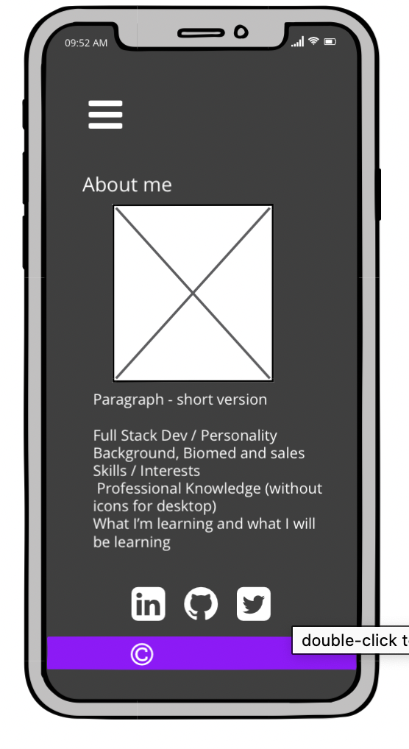
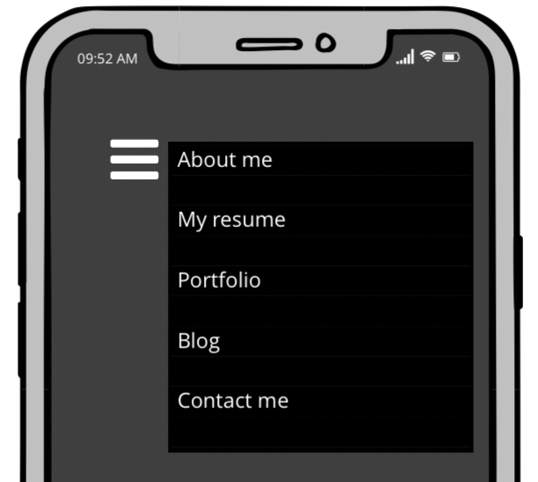
Mobile first ~ About me page & navigation
Black background with Aliceblue text
Header and footer to be in gradient theme colours
Every page to have a uniform hamburger menu when viewing on a phone
Every page to have a footer in the colour theme with a copyright mark in every type of viewing port
Website to include following pages:
About me
My resume
Portfolio
Blog
Contact me.
Hamburger menu on side with links to each page of the website
About me page to feature my skills, interests and personality
Notes:
Rather than the usual squares and rectangles I decided to use a series of chevrons which is a theme that begins in the About me Page
Use of a hamburger menu will ensure that the user can see a menu is available, without it taking up too much space
The image to fill the top half of the page under the header, followed by a paragraph highlighting my experience, skills, history and personality.

Slide 6
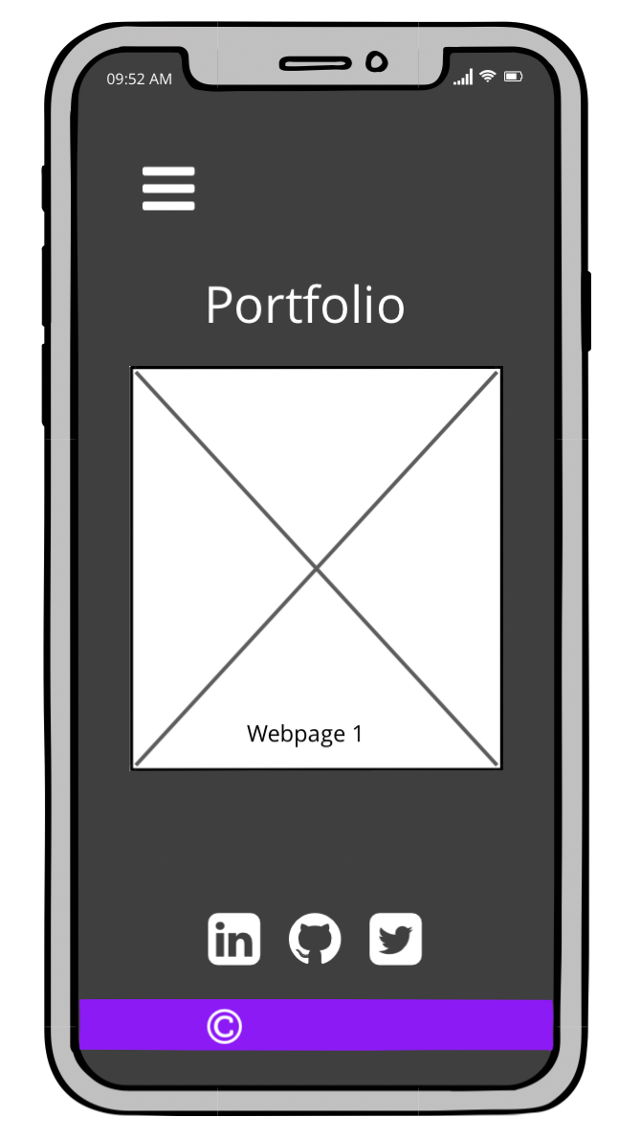
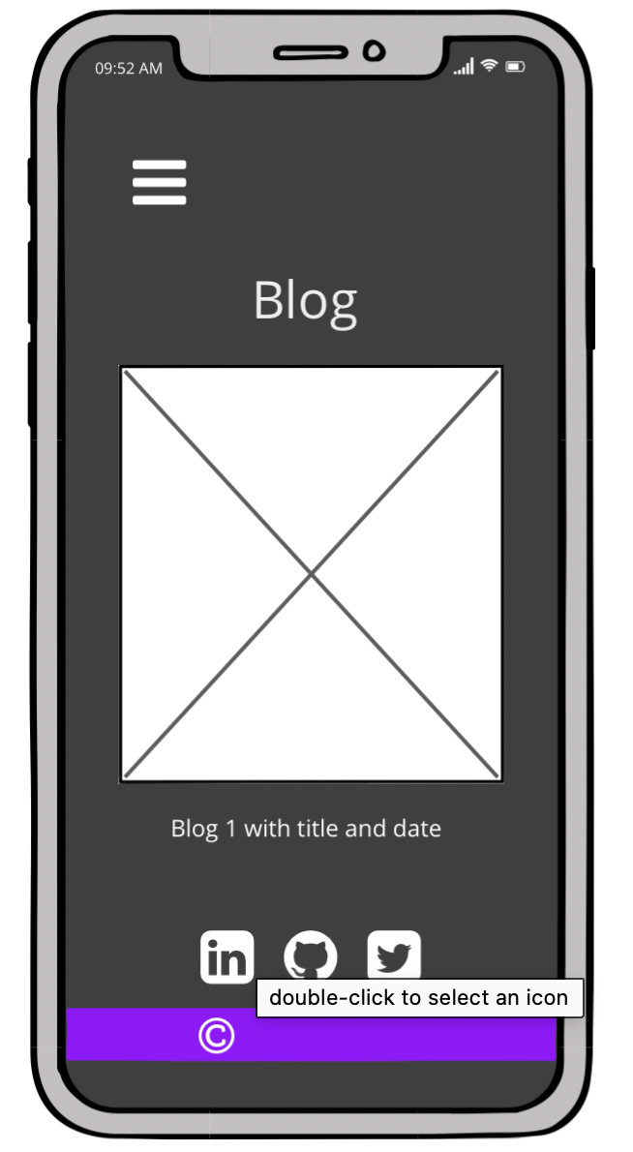
Blog and Portfolio Pages
6 x <section> to hold images related to the external website link, in the shape of a chevron, wrapped in anchor tags
6 dummy blogs on the blog page with dates and titles
One chevron wide on page when viewing on phone
Notes:
The chevron theme continues through to the portfolio page where there are 6 chevrons. The chevrons themselves are images within sections that are wrapped in anchor tags. Each portfolio link leads to a previous project. They are very rudimentary and I plan on redesigning or replacing these in due course as I progress in my skills and learning as well as adding actual blogs in due course
All the images are to have borders in the gradient theme colour to continue the theme. The section holding the image is to transform (scale up/translate) when mouse hovers on the element.
Again, the image takes up the whole width of the screen to allow the user to view the image without difficulty

Slide 7
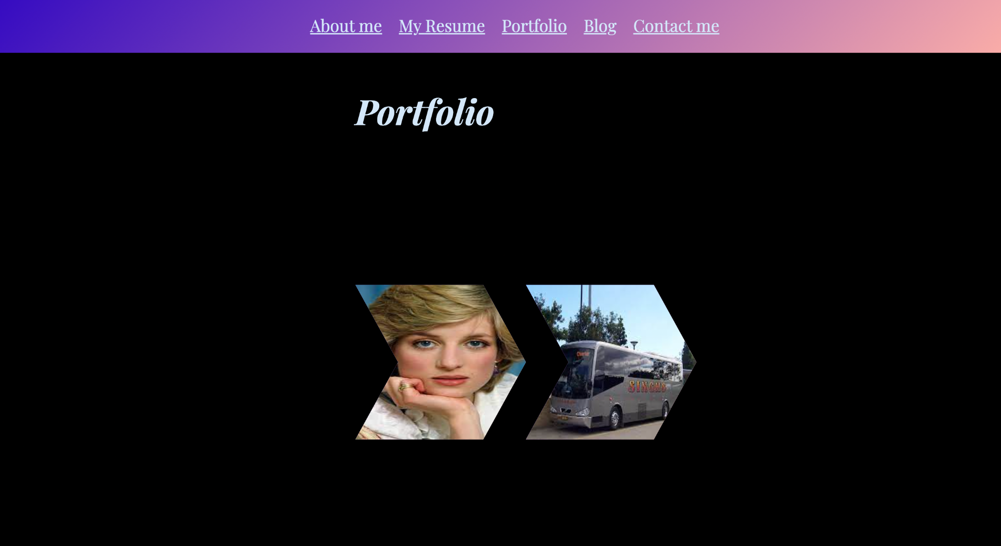
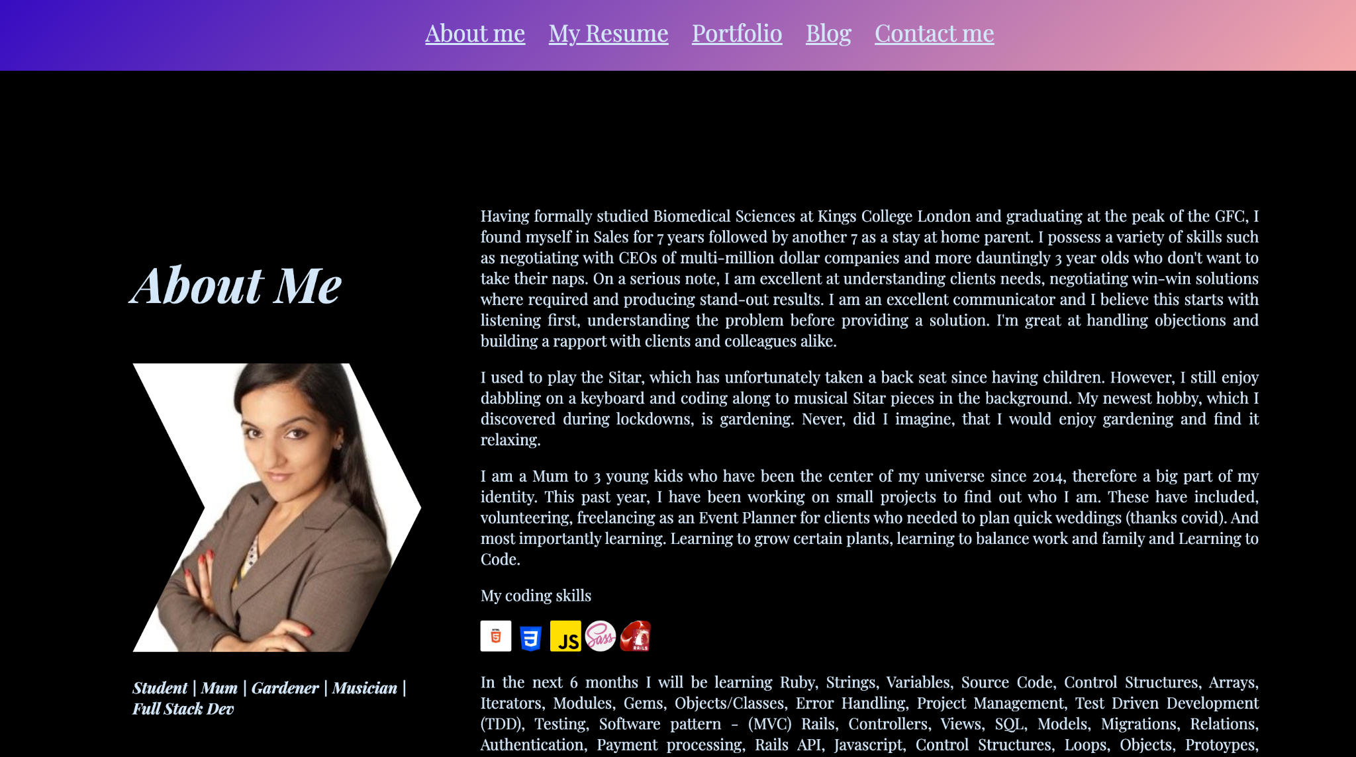
Colour theme & Chevron shaped Images in action
Notes:
Here you can see the chevrons and color theme in action, as I’ve mentioned them alot and they are main components of the website, I thought it imperative to view the actual product.

Slide 8
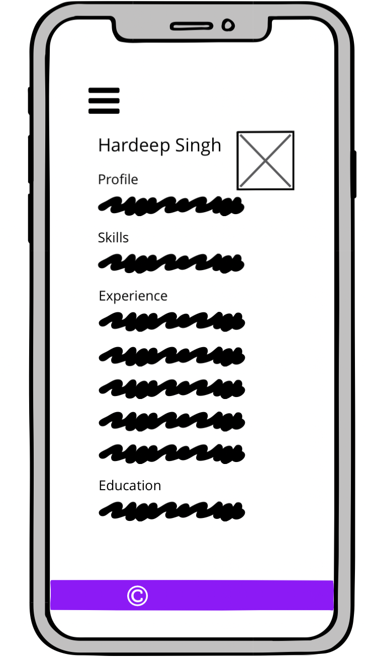
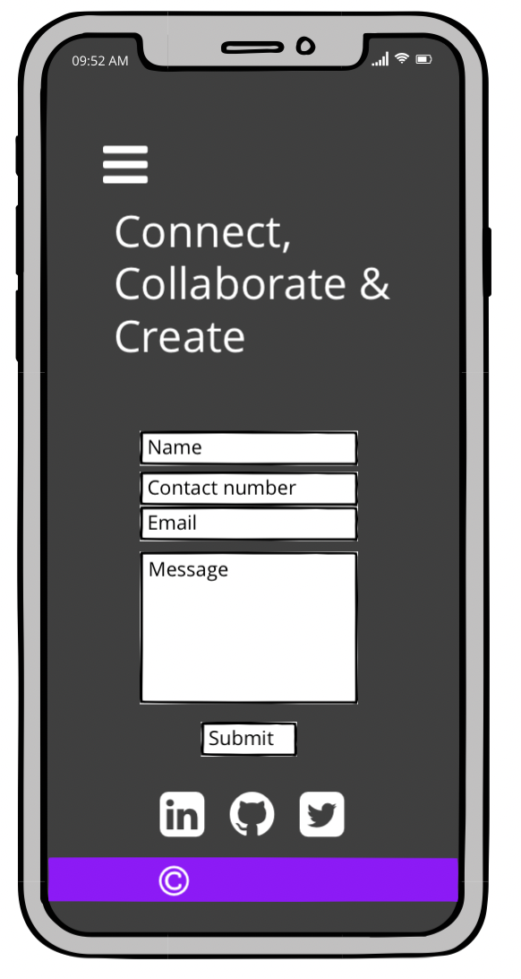
Resume and Contact me page
A page with my existing CV
CV needs to be updated every few months to include any new skills and experiences
A form for the users ease to get in touch
Form to be reactive and animated
No images on this page for ease of use and therefore a better UX
Notes:
The resume page will have an iframe tag holding a pdf of my existing CV, this will allow the user to easily view the CV, zoom in and out, download and print the CV.
CV needs to be updated every few months to include any new skills and experiences and using an iframe, makes it easy to update.
The call to action for this website is really for the user to get in touch with me about a potential job. So I will include a simple yet stylish form on the contact me page for the user to easily to get in touch. I’ll also include links to my social media such as Linked In where they can see reviews left by previous colleagues and managers. But most importantly I can see that this employer has viewed my profile.
No images on this page for ease of use and therefore a better UX

Slide 9
Components
Primary navigation located in the same location for every page with a hamburger menu in mobile view to save on space
Header and footer located at top and bottom respectively, of every page.
Each webpage is to have a title with Hardeep/Singh in it
Media queries for responsiveness
Visuals to include a profile picture of me, relevant images related to the webpages & blog page titles, most images to be in the shape of chevrons across all pages
Blog - to drive traffic through to the site
Notes:
Each page has a primary navigation located in the same space for ease of use to explore the site, whether viewed on desktop, mobile or tablet
There will be a hamburger menu in mobile view to save on space, it is easily recognisable as a dropdown menu and users will recognise that this is where the navigation items are listed
Header and footer located at top and bottom respectively, of every page. All to be in the theme colors.
Each webpage is to have a title with Hardeep/Singh in it
Visuals to include a profile picture of me, relevant images related to the webpages and blog page titles, Continuing the theme of the chevrons across all pages
Blog - to drive traffic through to the site

Slide 10
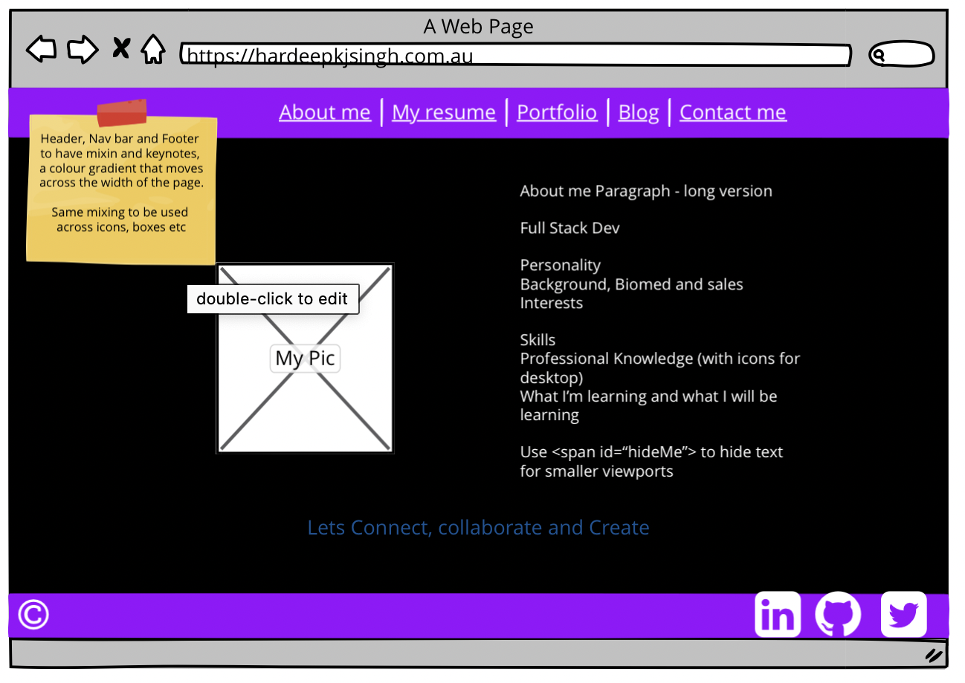
Desktop view - About me page
Chevron shaped profile picture, animated to translate onto the page like an arrow
Black background with Aliceblue text for a simple yet stylish look
All webpages will have a uniform nav bar, located in the same location for ease of use
All webpages will have a footer at the bottom which holds the copyright mark and links to social media
All headers and footers will be in the colour theme gradient, to stand out on the page and a better user experience
Notes:
The chevron and color theme continue with the website in desktop view. Here the profile picture will be in the shape of a chevron, which will be animated to translate onto the page like an arrow with the text about me placed next to it rather than under it. With the “white space” around the image to give the page balance. I think using a professional picture is very important for myself, as I do have an Indian name, I’m hoping by showing myself looking professional, well presented in a suit is an important tool that can be used to try and break down any discriminatory barriers.
Again I’m using a black background with aliceblue text just like mobile view
All webpages will have a uniform nav bar, located in the same location for ease of use
All webpages will have a footer at the bottom which holds the copyright mark as well as links to my social media which is a point of difference from mobile view.

Slide 11
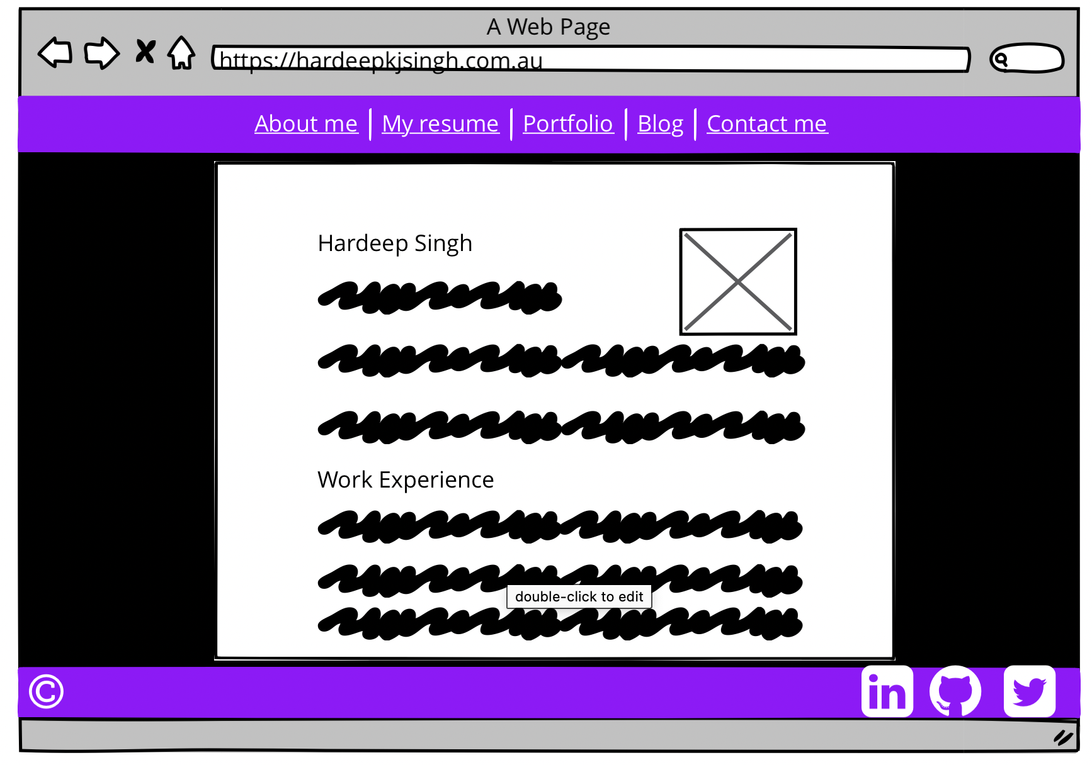
Resume page
PDF of my CV which will be downloadable for ease of use, especially by potential employers
Resume to have hyperlinks where appropriate
Notes:
Again the resume is downloadable and can easily be printed as its in an iframe, point of difference again is the footer with links to my social media.

Slide 12
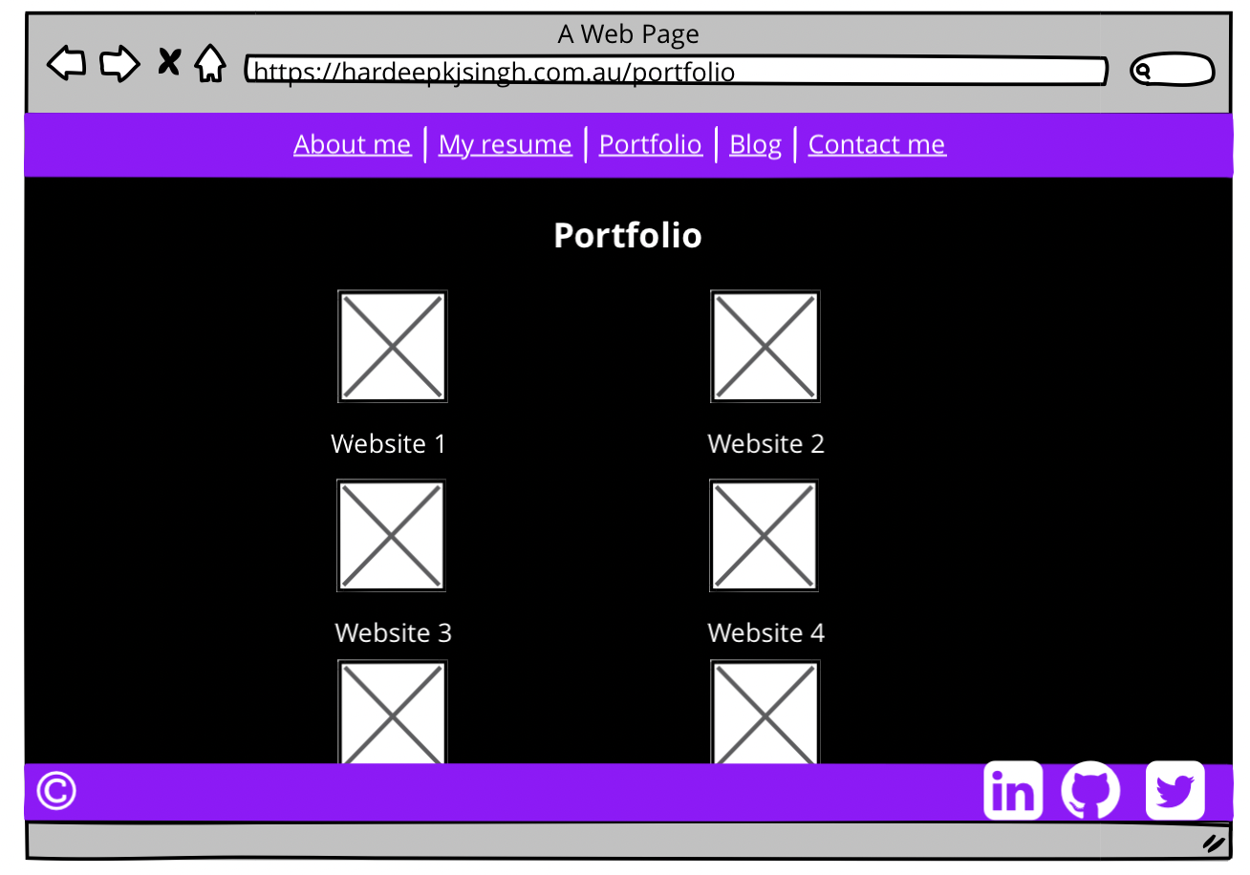
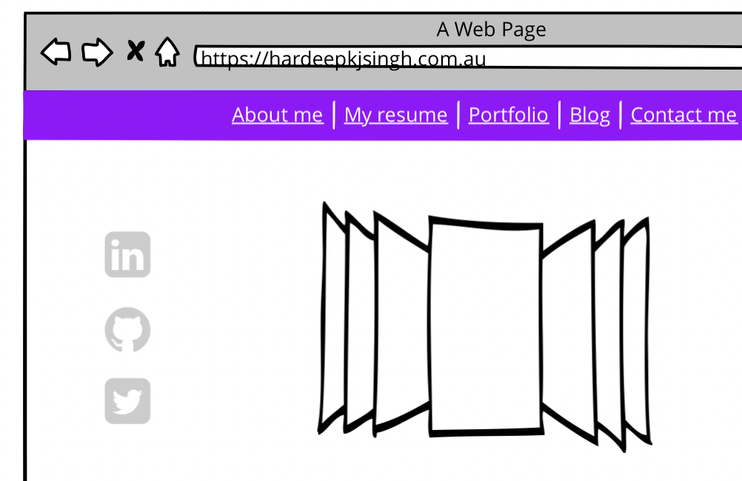
Portfolio page
There will be 6 links to previous created web pages
The links will wrap an image related to the webpage as well as descriptive title
The weblink images will be in the chevron shape
The chevrons will be animated to translate onto the page like arrows
Future project: create a cover flow of webpages for the portfolio
Notes:
I would have liked to have done a cover flow to present my different projects, however recognising my limitations I settled for something more simple, making a note of a potential future project.
Again like the mobile view, you have the 6 links, which are the chevron shaped images, they have been spaced out in 2 columns over 3 rows.

Slide 13
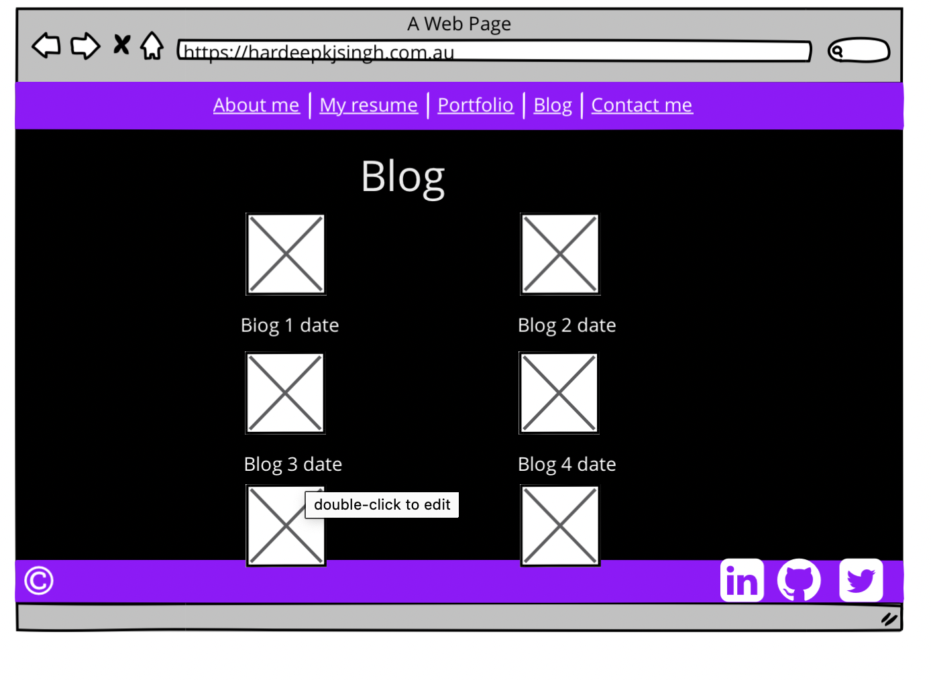
Blog page
There will be 6 links to dummy blogs
There will be images related to the dummy titles, the images will be wrapped in hyperlinks and shaped like chevrons
The chevrons will be animated to translate onto the page like arrows
Reflect the portfolio page in style
Notes:
With the blog page set up similarly but with the chevrons facing the opposite direction. There was no major reason behind this design choice, other than to make the portfolio and blog pages reflective of each other.

Slide 14
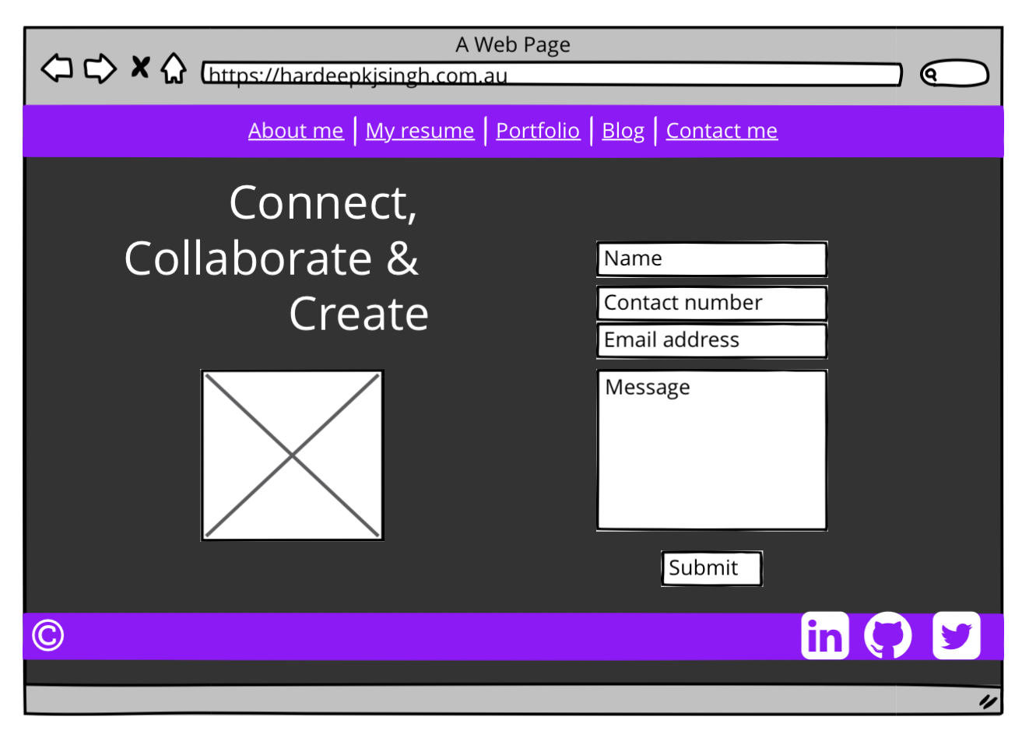
Contact me page
A simple form will make it easy for the user to get in touch, the name, contact number and email address will be a requirement
A generous textarea will allow the user to send an optional message
Continuing the chevron theme, an image will be animated to translate onto the page like arrows
Notes:
The contact me page is a simple yet stylish form where the user can enter their details to get in touch with me. There is a generous sized textarea should they wish to send a message as well as their details and the pseudo classes to make the form more interactive. Here in the desktop view, I will include an image as it can easily be presented without encroaching on the form. The aim of the whole website is to showcase my skills and entice the user to contact me about prospective employment. Other than the social media links, the contact me page is the best place the user can achieve that and so it’s best to make this page as user friendly as possible.

Slide 15
Challenges
I struggled to stop trying to add sprinkles to the website, for example:
Hamburger menu
Cover flow
A border in the color theme that shimmers around the chevrons
Layout/flexbox (I was regularly battling my footer)
These are all projects I can work on in time
Achievements
The color theme class which was used in the header, footer, images and a variety of other tags to be styled in future
Making the website stand out by using the chevrons

Slide 16
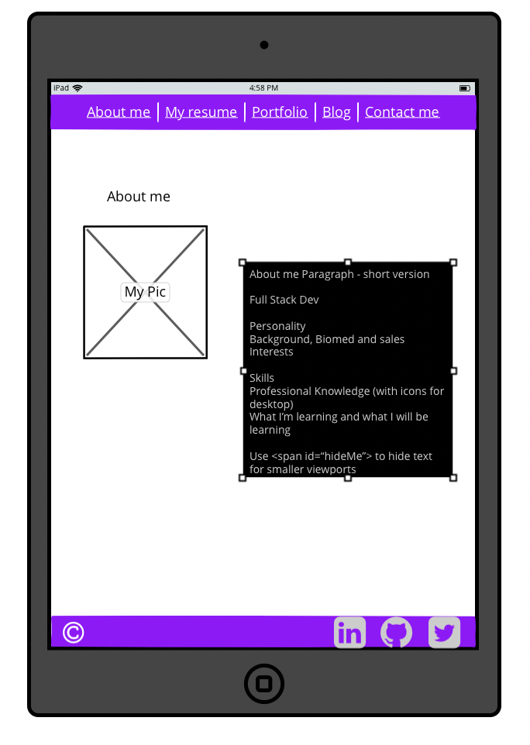
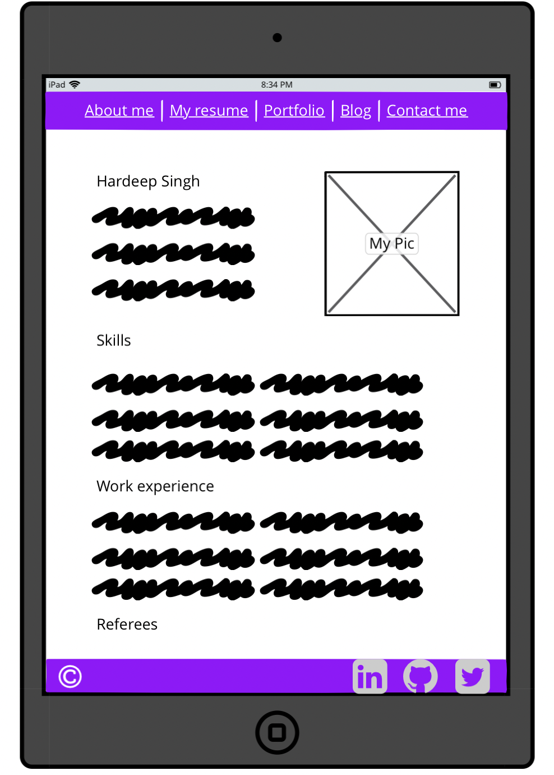
Portrait Tablet view ~ About me & Resume pages
The header at the top and footer at the bottom span the screen width and standout again in the color theme
The footer will hold my social media links on every page
Notes:
The header at the top and footer at the bottom span the screen width and standout again in the color theme
The footer will hold my social media links on every page

Slide 17
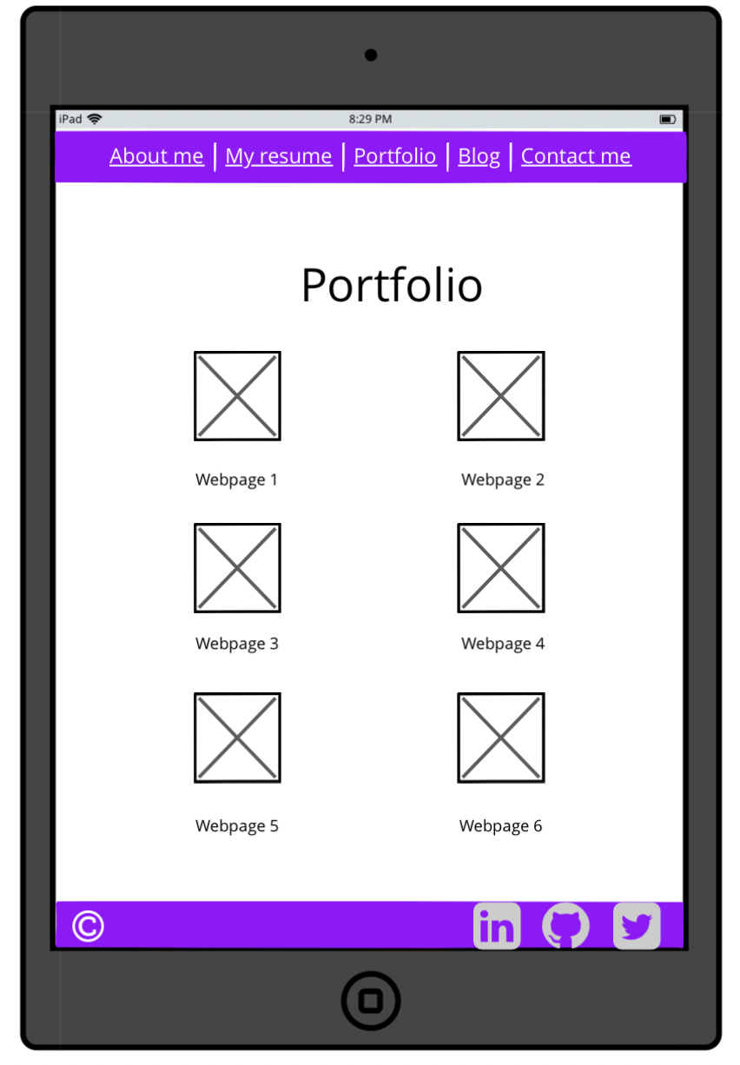
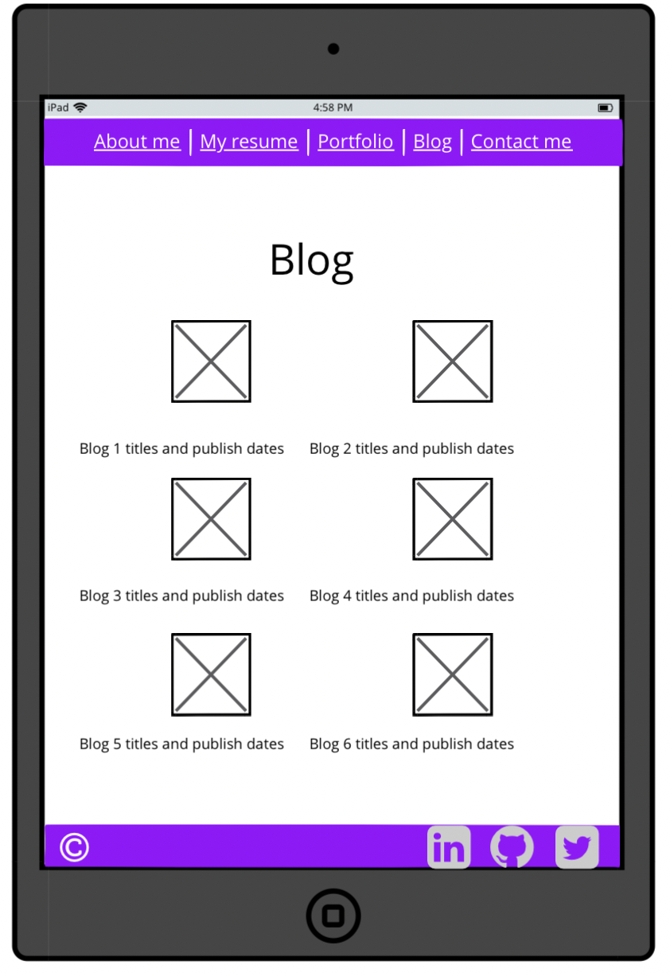
Portfolio and Blog Pages
The portfolio and blog pages are again reflections of each other
Notes:
The portfolio and blog pages are again reflections of each other

Slide 18
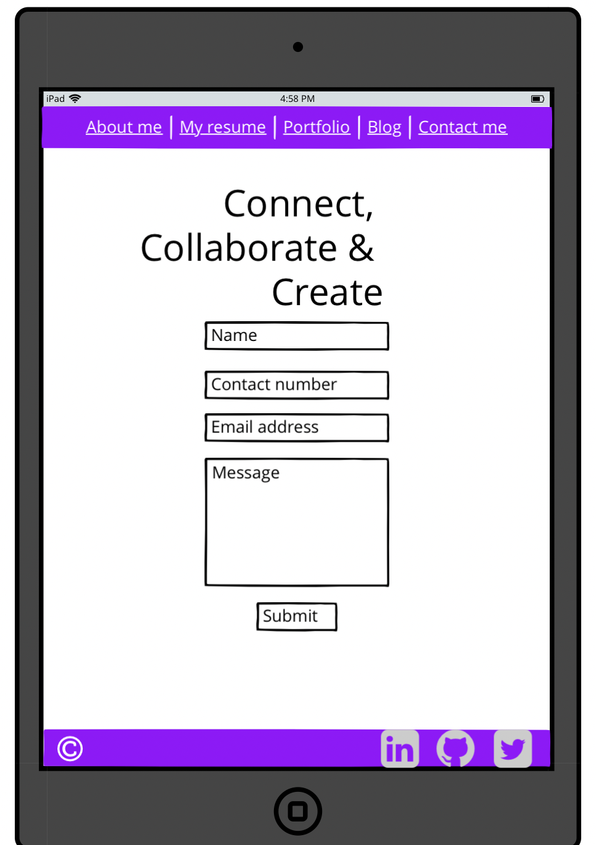
Contact me page
A simple contact me page without an image
Notes:
I opted for a simple contact me page without an image in tablet view

Slide 19
Ethics
Ensuring accessibility by including alternative text for images and semantic HTML
Built responsively for mobile, tablet and desktop
In consideration of my peers and educators, I have added comments in my code to section out the different pages in the stylesheet to make it easier to navigate
Copyright of images, where possible I have used my own images.
Notes:
Accessible by including alternative text for images
Built responsively for mobile, tablet and desktop
In consideration of my peers and educators, I have added comments in my code to section out the different pages in the stylesheet to make it easier to navigate
Copyright of images, where possible I have used my own images.

Slide 20
Thank you for your time and listening to my presentation today

